Slide 1

Is a Hot Dog a Sandwich?
Tiannah Griffith, Katie Lai, Dev Patel, Patrick Yin

Slide 2
Motivation
We want to find an answer to this controversial debate. We want to determine students' position on this controversial debate on the classification of a hot dog as a sandwich.

Slide 3
Hypothesis
Less than ½ of UVA full-time undergraduate students believe a hot dog is a sandwich

Slide 4
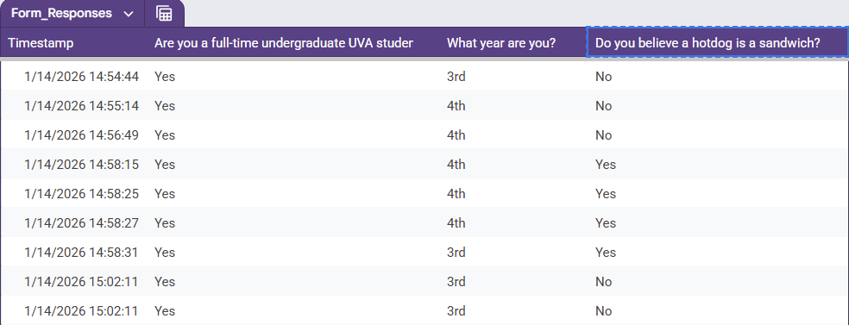
Data
A google form survey sent to UVA students. Results are shown on a google sheet file
80 Entries
4 Columns:
Timestamp – completion time
Are you a full-time undergraduate UVA student – binary answer
What year are you? - first, second, third, fourth
Do you believe a hotdog is a sandwich? - binary answer

Slide 5
Analysis Plan
Created exploratory charts to demonstrate the total number of yes and no responses
Look further into the number of yes or no responses based on the students’ class year
Look at the percentage of yes responses by class year

Slide 6
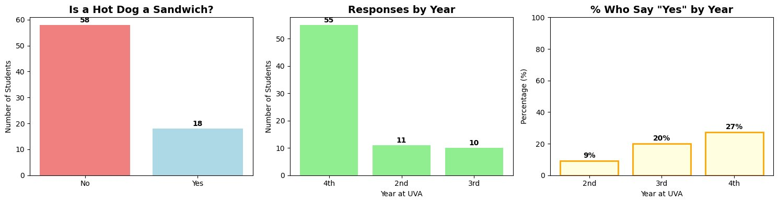
Results/Findings

Slide 7
Distribution
Year Representation:
1st: 0 students (0.0%)
2nd: 11 students (14.5%)
3rd: 10 students (13.2%)
4th: 55 students (72.4%)
Opinion by Year:
2nd: 9.1% say Yes
3rd: 20.0% say Yes
4th: 27.3% say Yes
Out of 76 UVA students:
18 say YES (23.7%) - hot dog IS a sandwich
58 say NO (76.3%) - hot dog IS NOT a sandwich

Slide 8
Evaluation of success
Based on just the results, most undergraduate students believe that a hotdog is not a sandwich
However:
Our data set lacked an even distribution of UVA undergrads
Contained 0 first-years
Cannot conclude for the whole population

Slide 9
Next Steps
Gather data from a wider sample of full time UVA students
Want data more representative of the true population
Perform statistical tests to test correlation

